Slide 1
Mathematics
Session 5: Calculating with letters
Haarlem
Peter Stikker
Notes:
Slides created by P. Stikker.
Version: 14 March 2019

Slide 2
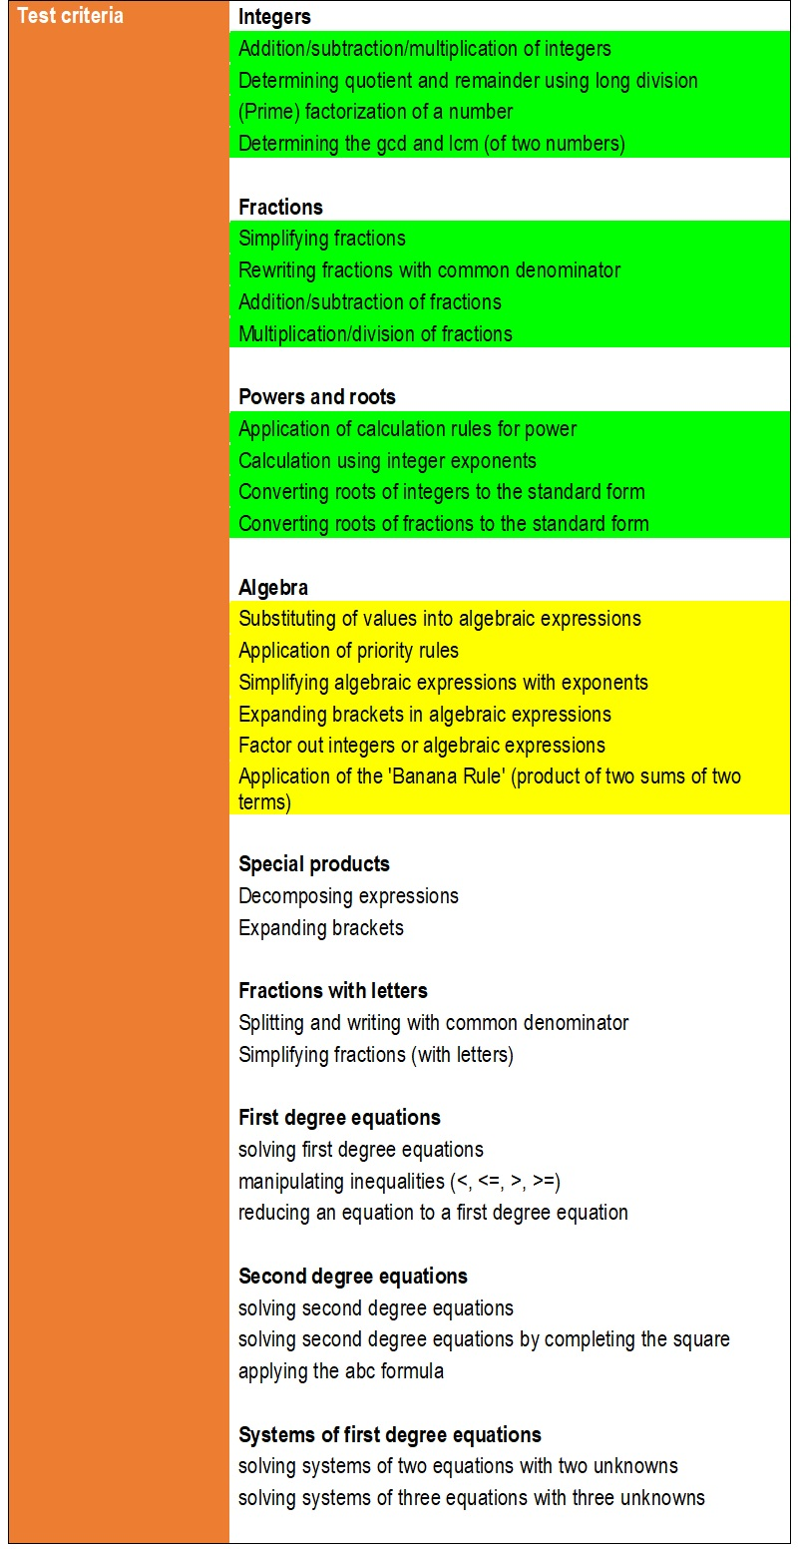
Today
Priority rules
Substitution
Powers with letters
Expanding brackets
Factor out terms
The banana formula

Slide 3
Algebra
Arithmetic is manipulation of numbers
Algebra is manipulation of numbers and variables (represented by letters)
The term algebra derives from the Arabic. الجبر al-jabr, from the Persian Muhammad ibn Mūsā al-Khwārizmī (around 830 AD)

Slide 4
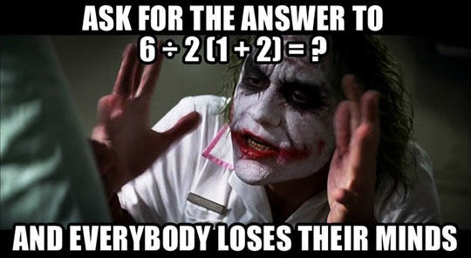
Segment 1: Priority rules
Know which operation to perform first

Slide 5
Priority rules
Most common priority (precedence) rules:
Parenthesis
Powers and Roots
Multiplication and Division
Addition and Subtraction
Operations in the same group, go from left to right.

Slide 6
Examples
Most common priority (precedence) rules:
Parenthesis
Powers and Roots
Multiplication and Division
Addition and Subtraction
Operations in the same group, go from left to right.
5 – 7 + 8 =
(5 – 7) + 8 =
-2 + 8 =
6
4 – 5 x 3 =
4 – (5 x 3) =
4 – 15 =
-11
3 x 3 =
6 ÷ 2(1 + 2) =
6 ÷ 2 x 3 =
(6 ÷ 2) x 3 =
9

Slide 7
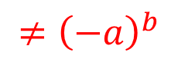
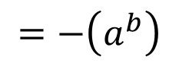
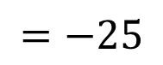
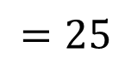
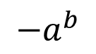
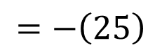
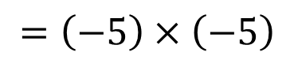
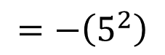
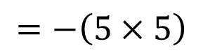
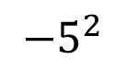
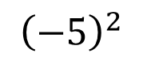
A special case
$$−a^{b}$$
$$=−\left(a^{b}\right)$$
$$≠{\left(−a\right)}^{b}$$
$$−5^{2}$$
$$=−\left(5^{2}\right)$$
$$=−\left(5×5\right)$$
$$=−\left(25\right)$$
$$=−25$$
$${\left(−5\right)}^{2}$$
$$=\left(−5\right)×\left(−5\right)$$
$$=25$$

Slide 8
Segment 2: Substitution
Able to substitute a variable in an expression by a value and determine the result

Slide 9
Substitution
Substitution in mathematics is replacing something by something else.
This ‘something’ in this course is usually a letter (e.g. a, b, c, etc.) and it gets replaced by a value.
Example:
Question: Replace a = 2 in the expression: -3 x a Answer: -3 x 2 = -6

Slide 10
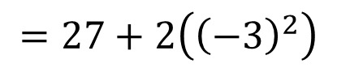
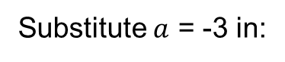
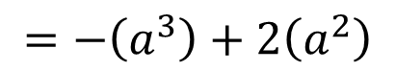
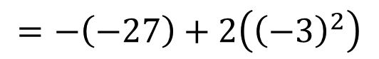
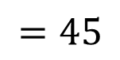
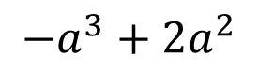
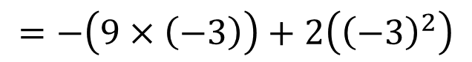
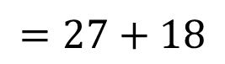
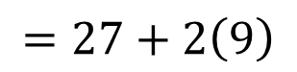
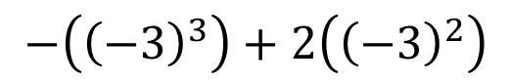
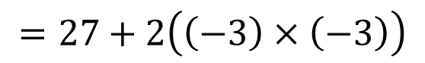
Substitution
Substitute $a$ = -3 in:
$$−a^{3}+2a^{2}$$
$$=−\left(a^{3}\right)+2\left(a^{2}\right)$$
$$−\left({\left(−3\right)}^{3}\right)+2\left({\left(−3\right)}^{2}\right)$$
Substitution algorithm:
Replace the letter by the substituted value between parenthesis
Work out the result
$$=−\left(\left(−3\right)×\left(−3\right)×\left(−3\right)\right)+2\left({\left(−3\right)}^{2}\right)$$
$$=−\left(9×\left(−3\right)\right)+2\left({\left(−3\right)}^{2}\right)$$
$$=−\left(−27\right)+2\left({\left(−3\right)}^{2}\right)$$
$$=27+2\left({\left(−3\right)}^{2}\right)$$
$$=27+2\left(\left(−3\right)×\left(−3\right)\right)$$
$$=27+2\left(9\right)$$
$$=27+18$$
$$=45$$

Slide 11

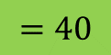
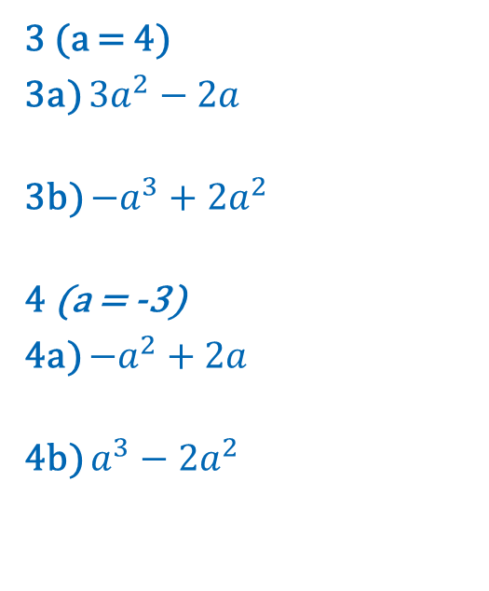
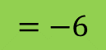
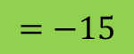
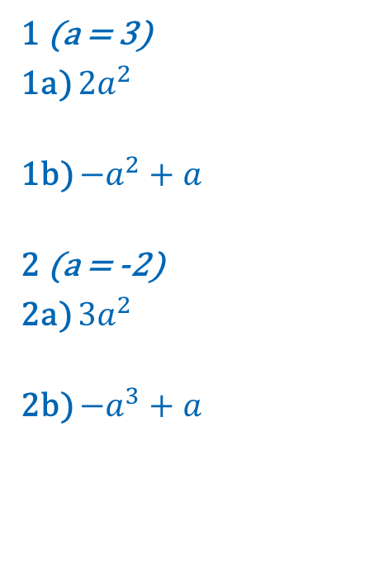
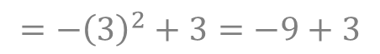
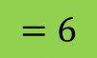

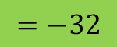
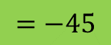
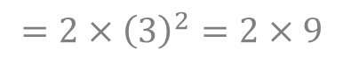

Practice 1, 2, 3, and 4
Substitute a = ? into the algebraic expressions and calculate the result:
1 (a = 3)
1a) $2a^{2}$
1b) $−a^{2}+a$
2 (a = -2)
2a) $3a^{2}$
2b) ${−a}^{3}+a$
3 (a = 4)
3a) $3a^{2}−2a$
3b) $−a^{3}+2a^{2}$
4 (a = -3)
4a) ${−a}^{2}+2a$
4b) $a^{3}−2a^{2}$
$$=18$$
$$=40$$
$$=2×{\left(3\right)}^{2}=2×9$$
$$=3×{\left(4\right)}^{2}−2×4=3×16−8=48−8$$
$$=−6$$
$$=−32$$
$$={−\left(3\right)}^{2}+3=−9+3$$
$$=−{\left(4\right)}^{3}+2×{\left(4\right)}^{2}=−64+2×16=−64+32$$
$$=12$$
$$=−15$$
$$={3×\left(−2\right)}^{2}=3×4$$
$$=−{\left(−3\right)}^{2}+2×\left(−3\right)=−9+−6=−9−6$$
$$=6$$
$$=−45$$
$$={−\left(−2\right)}^{3}+−2=−\left(−8\right)−2=8−2$$
$$={\left(−3\right)}^{3}−2×{\left(−3\right)}^{2}=−27−2×9=−27−18$$

Slide 12
Segment 3: Powers
Able to work with powers and letters

Slide 13
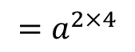
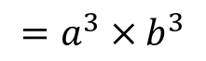
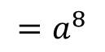

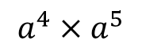

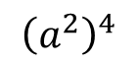
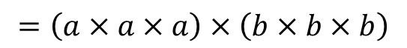
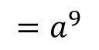

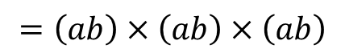
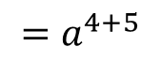
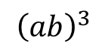
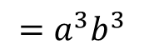
Power properties (already covered in session 4)
$$a^{4}×a^{5}$$
$$=\left(a×a×a×a\right)×\left(a×a×a×a×a\right)$$
$$=a^{4+5}$$
$$=a^{9}$$
P1 | $$a^{p}×a^{q} =a^{p+q}$$
4 times
5 times
$${\left(a^{2}\right)}^{4}$$
$=\left(a×a\right)×\left(a×a\right)×\left(a×a\right)$ $×\left(a×a\right)$
$$=a^{2×4}$$
$$=a^{8}$$
P3 | $${\left(a^{p}\right)}^{q} =a^{p×q}$$
4 times 2 = 8 times
$${\left(ab\right)}^{3}$$
$$=\left(ab\right)×\left(ab\right)×\left(ab\right)$$
$$=\left(a×a×a\right)×\left(b×b×b\right)$$
$$=a^{3}×b^{3}$$
$$=a^{3}b^{3}$$
3 times
3 times
3 times
P4 | $${\left(a×b\right)}^{p}=a^{p}×b^{p}$$

Slide 14
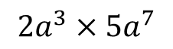

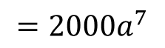
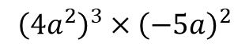

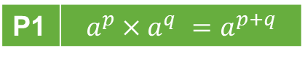



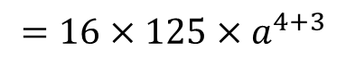
























More examples
P3 | $${\left(a^{p}\right)}^{q} =a^{p×q}$$
P1 | $$a^{p}×a^{q} =a^{p+q}$$
$${\left(a^{2}b^{4}\right)}^{3}$$
$$={\left(a^{2}\right)}^{3}×{\left(b^{4}\right)}^{3}$$
$$=a^{2×3}×b^{4×3}$$
$$=a^{6}b^{12}$$
$$2a^{3}×5a^{7}$$
$$=2×5×a^{3}×a^{7}$$
$$=10×a^{3+7}$$
$$=10a^{10}$$
P4 | $${\left(a×b\right)}^{p}=a^{p}×b^{p}$$
B4 | $$a×b=b×a$$
B4 | $$a×b=b×a$$
$${\left(2a\right)}^{4}×{\left(5a\right)}^{3}$$
$$=2^{4}×a^{4}×5^{3}×a^{3}$$
$$=2^{4}×5^{3}×a^{4}×a^{3}$$
$$=16×125×a^{4+3}$$
$$=2000a^{7}$$
P4 | $${\left(a×b\right)}^{p}=a^{p}×b^{p}$$
P1 | $$a^{p}×a^{q} =a^{p+q}$$
$${\left(−2a\right)}^{7}$$
$$={\left(−2\right)}^{7}×a^{7}$$
$$=−128a^{7}$$
P4 | $${\left(a×b\right)}^{p}=a^{p}×b^{p}$$
P3 | $${\left(a^{p}\right)}^{q} =a^{p×q}$$
P1 | $$a^{p}×a^{q} =a^{p+q}$$
$${\left(4a^{2}\right)}^{3}×{\left(−5a\right)}^{2}$$
$$={\left(4\right)}^{3}×{\left(a^{2}\right)}^{3}×{\left(−5\right)}^{2}×{\left(a\right)}^{2}$$
$$=64×a^{2×3}×25×a^{2}$$
$$=64×25×a^{6}×a^{2}$$
$$=1600×a^{6+2}$$
P4 | $${\left(a×b\right)}^{p}=a^{p}×b^{p}$$
B4 | $$a×b=b×a$$
$$=1600a^{8}$$

Slide 15


















Practice 5
Simplify the following expressions:
a. $a^{3}×a^{5}$
b. $b^{3}×b^{2}$ c. ${\left(a^{2}\right)}^{3}$ d. ${\left(b^{3}\right)}^{4}$
e. ${\left(ab\right)}^{4}$ f. ${\left(a^{2}b^{3}\right)}^{2}$ g. $a^{4}×a^{3}×a$
h. ${2a}^{5}×{3a}^{5}$
$$=a^{3+5}$$
$$=a^{8}$$
$$=a^{4}×b^{4}$$
$$=a^{4}b^{4}$$
$$=b^{3+2}$$
$$=b^{5}$$
$$={\left(a^{2}\right)}^{2}×{\left(b^{3}\right)}^{2}=a^{2×2}×b^{3×2}$$
$$=a^{4}b^{6}$$
$$=a^{2×3}$$
$$=a^{6}$$
$$=a^{4+3+1}$$
$$=a^{8}$$
$$=b^{3×4}$$
$$=b^{12}$$
$$=2×3×a^{5}×a^{5}=6×a^{5+5}$$
$$=6a^{10}$$

Slide 16
Segment 4: Basic brackets
Able to remove a set of brackets

Slide 17

Brackets rule 1
a
b
c
b + c
We take a rectangle
with height a
and width b
The area of this rectangle is therefor: a x b
We add a second rectangle with the same height
and width c
The area of this rectangle is therefor: a x c
The total length of the combined rectangles is now b + c
The total area of both rectangles is therefor: a x (b + c)
Or by adding the two seperately: a x b + a x c
These two should be the same, so:
$$a\left(b+c\right)=a×b+a×c$$

Slide 18






Example 1
$$3ab\left(c+2b\right)$$
$$=3ab×c+3ab×2b$$
$$=3abc+3×a×b×2×b$$
$$=3abc+3×2×a×b×b$$
$$=3abc+6×a×b^{2}$$
$$=3abc+6ab^{2}$$

Slide 19





Example 2
$$5a^{2}\left(4b−2c\right)$$
$$=5a^{2}\left(4b+−2c\right)$$
$$=5a^{2}×4b+5a^{2}×\left(−2c\right)$$
$$=5×a^{2}×4×b+5×a^{2}×\left(−2×c\right)$$
$$=5×4×a^{2}×b+5×\left(−2\right)×a^{2}×c$$
$$=20×a^{2}×b+−10×a^{2}×c$$
$$=20a^{2}b−10a^{2}c$$

Slide 20
















Practice 6
Expand all the brackets:
a. $3\left(2a+5\right)$ b. $8\left(5a−2\right)$ c. $2a\left(a−5\right)$ d. $7a\left(2a+12\right)$
e. $2a\left(a^{2}+9\right)$ f. $3a^{2}\left(4a−7\right)$ g. $4a^{2}\left(3a^{2}+2a+3\right)$ h.$−3a^{2}\left(2a^{3}+5a^{2}−a\right)$
$$=6a+15$$
$$=2a^{3}+18a$$
$$=\left(3×2a\right)+\left(3×5\right)$$
$$=\left(2a×a^{2}\right)+\left(2a×9\right)$$
$$=40a−16$$
$$=12a^{3}−21a^{2}$$
$$=\left(8×5a\right)+\left(8×\left(−2\right)\right)$$
$$=\left(3a^{2}×4a\right)+\left(3a^{2}×\left(−7\right)\right)$$
$$=2a^{2}−10a$$
$$=12a^{4}+8a^{3}+12a^{2}$$
$$=\left(2a×a\right)+\left(2a×\left(−5\right)\right)$$
$$=\left(4a^{2}×3a^{2}\right)+\left(4a^{2}×2a\right)+\left(4a^{2}×3\right)$$
$$=14a^{2}+84a$$
$$=−6a^{5}−15a^{4}+3a^{3}$$
$$=\left(7a×2a\right)+\left(7a×12\right)$$
$$=\left(−3a^{2}×2a^{3}\right)+\left(−3a^{2}×5a^{2}\right)+\left(−3a^{2}×−a\right)$$

Slide 21
Segment 5: Factoring out
Able to factor out expressions

Slide 22
Factor out
“Factoring is the opposite of distributing. When distributing, you multiply a series of terms by a common factor. When factoring, you seek to find what a series of terms have in common and then take it away, dividing the common factor out from each term.” (Dummies, n.d.)

Slide 23














Algorithm and example
$$3a^{2}b^{4}c+6ab^{6}+6ab^{3}c$$
Determine the terms in the expression
For each term, determine the GCD of each of the values in all terms
Place the GCD outside a set of brackets and divide each term by the GCD
Determine if each term have a letter in common. If not, then continue to step 5, else
Divide each term by the letter to the power of the lowest power among the terms.
Place the letter and the highest power also outside the brackets
Repeat step 4 with the remaining terms
Place the remaining terms inside the brackets.
$$GCD\left(3,3,6\right)=3$$
$$\frac{3a^{2}b^{4}c}{3}=a^{2}b^{4}c$$
$$\frac{6ab^{6}}{3}=2ab^{6}$$
$$\frac{6ab^{3}c}{3}=2ab^{3}c$$
$$3\left(a^{2}b^{4}c+2ab^{6}+2ab^{3}c\right)$$
$$\frac{a^{2}b^{4}c}{a}=ab^{4}c$$
$$\frac{2ab^{6}}{a}=2b^{6}$$
$$\frac{2ab^{3}c}{a}=2b^{3}c$$
$$3a\left(ab^{4}c+2b^{6}+2b^{3}c\right)$$
$$\frac{ab^{4}c}{b^{3}}=abc$$
$$\frac{2b^{6}}{b^{3}}=2b^{3}$$
$$\frac{2b^{3}c}{b^{3}}=2c$$
$$3ab^{3}\left(abc+2b^{3}+2c\right)$$

Slide 24
















Practice 7
Factor out as many integers or algebraic expressions as possible:
a. $6a+12$ b. $12a+16$ c. $3a−6b+9$ d. $12a+8b−16$
e. $−6a+9b−15$ f. $a^{2}+a$ g. $−14a+35b−21$
h. $a^{3}−a^{2}$
$$=6\left(a+2\right)$$
$$=−3\left(2a−3b+5\right)$$
$$=\left(6×a\right)+\left(6×2\right)$$
$$=\left(−3×2a\right)+\left(−3×−3b\right)+\left(−3×5\right)$$
$$=4\left(3a+4\right)$$
$$=a\left(a+1\right)$$
$$=\left(4×3a\right)+\left(4×4\right)$$
$$=\left(a×a\right)+\left(a×1\right)$$
$$=3\left(a−2b+3\right)$$
$$=−7\left(2a−5b+3\right)$$
$$=\left(3×a\right)+\left(3×−2b\right)+\left(3×3\right)$$
$$=\left(−7×2a\right)+\left(−7×−5b\right)+\left(−7×3\right)$$
$$=4\left(3a+2b−4\right)$$
$$=a^{2}\left(a−1\right)$$
$$=\left(4×3a\right)+\left(4×2b\right)+\left(4×−4\right)$$
$$=\left(a^{2}×a\right)+\left(a^{2}×−1\right)$$

Slide 25
Segment 6: The banana formula
Able apply the banana formula

Slide 26





The banana formula
$$\left(a+b\right)\left(c+d\right)$$
$$=ac$$
$$+ad$$
$$+bc$$
$$+bd$$

Slide 27
The banana formula: Visual
c+ d
d
c
a
b
a + b
The area of the yellow rectangle is:
a x c
The total width is:
a + b
The area of the green rectangle is:
a x d
The total height is:
c + d
The area of the purple rectangle is:
b x c
Total area therefor:
(a + b) x (c + d)
The area of the blue rectangle is:
b x d
______ +
In total therefor:
a x c + a x d + b x c + b x d
$$\left(a+b\right)\left(c+d\right)=ac+ad+bc+bd$$

Slide 28











The banana formula: proof
$$\left(a+b\right)\left(c+d\right)$$
Br1 | $$a\left(b+c\right)=ab+ac$$
$$=\left(a+b\right)c+\left(a+b\right)d$$
B4 | $$a×b=b×a$$
$$=c\left(a+b\right)+d\left(a+b\right)$$
Br1 | $$a\left(b+c\right)=ab+ac$$
$$=ca+cb+da+db$$
B4 | $$a×b=b×a$$
$$=ac+bc+ad+bd$$
B5 | $$a+b=b+a$$
$$=ac+ad+bc+bd$$

Slide 29













Example
$$\left(3a^{2}+7bc\right)\left(5ab−2c\right)$$
$$3a^{2}×5ab$$
$$=3×5×a^{2}×a×b$$
$$=15a^{3}b$$
$$3a^{2}×\left(−2\right)c$$
$$=\left(−2\right)×3×a^{2}×c$$
$$=−6a^{2}c$$
$$7bc×5ab$$
$$=7×5×a×b×b×c$$
$$=35ab^{2}c$$
$$7bc×\left(−2\right)c$$
$$=\left(−2\right)×7×b×c×c$$
$$=−14bc^{2}$$
$$=15a^{3}b+−6a^{2}c+35ab^{2}c+−14bc^{2}$$
$$=15a^{3}b−6a^{2}c+35ab^{2}c−14bc^{2}$$

Slide 30















Practice 8: Expand the brackets:
a. $\left(a+3\right)\left(a+1\right)$ b. $\left(2a+3\right)\left(a+3\right)$
c. $\left(−3a+8\right)\left(8a−3\right)$
d. $\left(7a+12\right)\left(8a−11\right)$
$$=\left(a×a\right)+\left(a×1\right)+\left(3×a\right)+\left(3×1\right)$$
$$=a^{2}+4a+3$$
$$=\left(a^{2}\right)+\left(a\right)+\left(3a\right)+\left(3\right)$$
$$=\left(2a×a\right)+\left(2a×3\right)+\left(3×a\right)+\left(3×3\right)$$
$$=2a^{2}+9a+9$$
$$=\left(2a^{2}\right)+\left(6a\right)+\left(3a\right)+\left(9\right)$$
$$=\left(−3a×8a\right)+\left(−3a×−3\right)+\left(8×8a\right)+\left(8×−3\right)$$
$$=−24a^{2}+73a−24$$
$$=\left(−24a^{2}\right)+\left(9a\right)+\left(64a\right)+\left(−24\right)$$
$$=\left(7a×8a\right)+\left(7a×−11\right)+\left(12×8a\right)+\left(12×−11\right)$$
$$=56a^{2}+19a−132$$
$$=\left(56a^{2}\right)+\left(−77a\right)+\left(96a\right)+\left(−132\right)$$
e. $\left(−4a+1\right)\left(b−1\right)$
f. $\left(3a−1\right)\left(−b+3\right)$
g. $\left(2a^{2}−7\right)\left(a+7\right)$
h. $\left(−3a^{2}+2\right)\left(−2a^{2}+3\right)$
$$=\left(−4a×b\right)+\left(−4a×−1\right)+\left(1×b\right)+\left(1×−1\right)$$
$$=4a−4ab+b−1$$
$$=\left(−4ab\right)+\left(4a\right)+\left(b\right)+\left(−1\right)$$
$$=\left(3a×−b\right)+\left(3a×3\right)+\left(−1×−b\right)+\left(−1×3\right)$$
$$=9a−3ab+b−3$$
$$=\left(−3ab\right)+\left(9a\right)+\left(b\right)+\left(−3\right)$$
$$=\left(2a^{2}×a\right)+\left(2a^{2}×7\right)+\left(−7×a\right)+\left(−7×7\right)$$
$$=2a^{3}+14a^{2}−7a−49$$
$$=\left(2a^{3}\right)+\left(14a^{2}\right)+\left(−7a\right)+\left(−49\right)$$
$$=\left(−3a^{2}×−2a^{2}\right)+\left(−3a^{2}×3\right)+\left(2×−2a^{2}\right)+\left(2×3\right)$$
$$=6a^{4}−13a^{2}+6$$
$$=\left(6a^{4}\right)+\left(−9a^{2}\right)+\left(−4a^{2}\right)+\left(6\right)$$

Slide 31
Closure
Overview & H☺mew☹rk

Slide 32

































Overview so far…
Fraction rules
Power rules
F1 | $$\frac{a}{b}=\frac{a×c}{b×c}=\frac{a/c}{b/c}$$
P1 | $$a^{p}×a^{q} =a^{p+q}$$
Notation rules
P2 | $$a^{p}:a^{q}=a^{p−q}$$
N1 | $$\frac{a}{b}=a/b=a:b$$
F2 | $$\frac{a}{b}+\frac{c}{b}=\frac{a+c}{b}$$
P3 | $${\left(a^{p}\right)}^{q} =a^{p×q}$$
N2 | $$a^{p}=a×a×…×a (p \text{times})$$
F3 | $$\frac{a}{b}−\frac{c}{b}=\frac{a−c}{b}$$
P4 | $${\left(a×b\right)}^{p}=a^{p}×b^{p}$$
N3 | $$a^{1}=a$$
P5 | $${\left(\frac{a}{b}\right)}^{p}=\frac{a^{p}}{b^{p}}$$
F4 | $$\frac{a}{b}×c=\frac{a×c}{b}$$
N4 | $$a×b=a∙b=ab$$
P6 | $$a^{−p}=\frac{1}{a^{p}}$$
N5 | $$\sqrt{a}=\sqrt[2]{a}$$
F5 | $$\frac{a}{b}×\frac{c}{d}=\frac{a×c}{b×d}$$
Root rules
Basic rules
F6 | $${\frac{a}{b}}/c=\frac{a}{b×c}$$
R1 | $$\sqrt{a^{2}}=a$$
R1 | $$\sqrt[n]{a^{n}}=a$$
B1 | $$\frac{a}{1}=a$$
R2 | $${\left(\sqrt[n]{a}\right)}^{n}=a$$
F7 | $${\frac{a}{b}}/{\frac{c}{d}}=\frac{a×d}{b×c}$$
R2 | $${\left(\sqrt{a}\right)}^{2}=a$$
B2 | $$\frac{a}{a}=1$$
R3 | $$\sqrt[n]{a}×\sqrt[n]{b}=\sqrt[n]{a×b}$$
R3 | $$\sqrt{a}×\sqrt{b}=\sqrt{a×b}$$
Brackets rules
R4 | $$\frac{a}{\sqrt{b}}=\frac{a}{b}\sqrt{b}$$
B3 | $$a×1=a$$
B4 | $$a×b=b×a$$
Br1 | $$a\left(b+c\right)=ab+ac$$
R5 | $$\sqrt{\frac{a}{b}}=\frac{1}{b}\sqrt{a×b}$$
B5 | $$a+b=b+a$$
Br2 | $$\left(a+b\right)\left(c+d\right)=ac+ad+bc+bd$$

Slide 33

H☺me W☹rk
Theory: Chapter 4, pages 30-39
Selected exercises: page 30: 4.1 4.2 4.3 4.4 4.5 page 32: 4.9 4.10 4.11 4.12 4.13 4.14 4.15
page 34: 4.21 4.22 4.23 4.24
page 36: 4.33 4.34 4.35 4.36 4.37
page 38: 4.45 4.46 4.47 4.48

